Slide 1
Random Forest Model Introduction

Slide 2
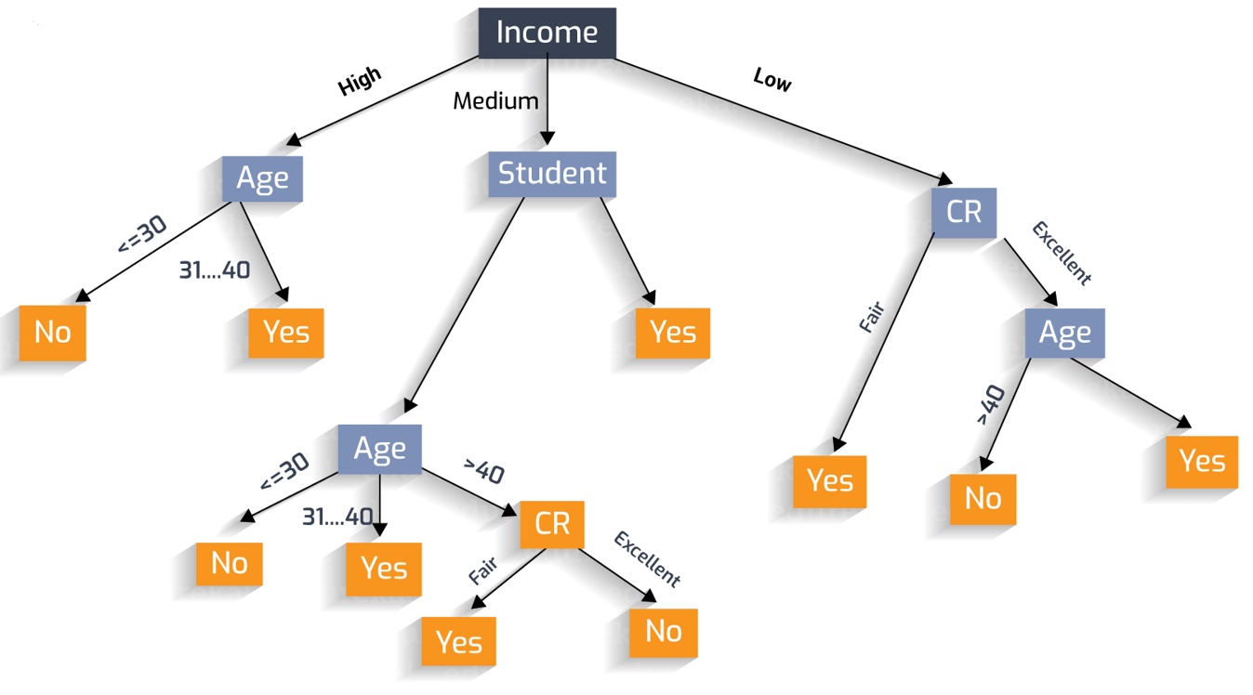
Decision Tree
A supervised learning algorithm based on if rules and tree structure
Each internal node in the tree represents a judgment of an attribute
The last leaf node represents a classification result
Example
When you want to predict the outcome of a new data, follow these branches to find the answer !
Notes:
Each internal node in the tree represents a judgment of an attribute, which means that this is an empirical conclusion based on past data. Each branch represents the output of a judgment result, and the last leaf node represents a classification result. Then we can get results for each type of customer.

Slide 3

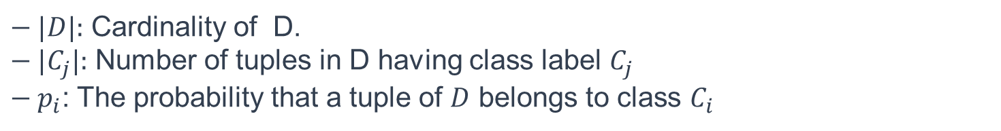
How to rank the node in the Tree?
Gain Ratio
Information Gain
Gini Index (default)
$Gini_{index}\left(A\right)=gini\left(D\right)−gini_{A}(D)$ Select the highest!!
$gini_{A}\left(D\right)=\sum_{i=1}^{n}{\frac{\left|D_{i}\right|}{\left|D\right|}gini\left(D_{i}\right)}$ where n is number of subset of Attribute A.
$gini\left(D\right)=1−\sum_{i=1}^{m}{p_{i}^{2}}$ where D has m distinct class values
$− |D|:$ Cardinality of D.
$− |C_{j}|:$ Number of tuples in D having class label $C_{j}$
$− p_{i}$: The probability that a tuple of $D$ belongs to class $C_{i}$
Notes:
When we build the tree, we should rank the node in the tree, the attribute with the most classification ability should be split first. Here we list three useful and most common method to measure the classification ability. Gain ratio, information gain, gini index. Here we use the gini index to calculate. Here is the algorithm of tt.
$gini_{A}\left(D\right)=\sum_{i=1}^{n}{\frac{\left|D_{i}\right|}{\left|D\right|}gini\left(D_{i}\right)}$ where n is number of subset of Attribute A. Weight sum
Pi label.

Slide 4
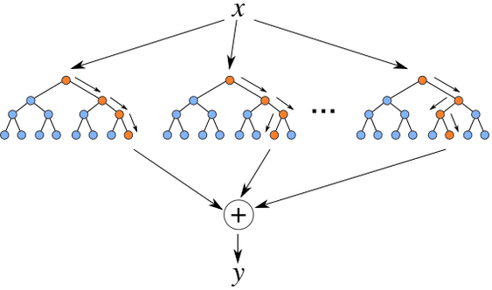
Tree grows into forest $−$ Random forests
Made of great quantity decision trees
No association between different decision trees
Each decision tree makes judgments and categories in the forest
Treat the most result as the final output
Notes:
Here is the structure of the randomforest, Random forests are made of many decision trees, and there is no association between different decision trees. When we conduct classified tasks, new input samples enter, let each decision tree in the forest make judgment and classification, each decision tree, will get its own classification result, which is classified in the decision tree The most, then the random forest will treat this result as the final result.

Slide 5
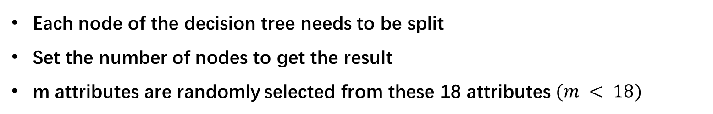
Basic Flow of Random Forest
Row sampling:
Random sampling for the total data with replacement (bootstrap)
If the number of total data is N, then sample N times
Sample data serves as the input of each tree
2. Column sampling
Each node of the decision tree needs to be split
Set the number of nodes to get the result
m attributes are randomly selected from these 18 attributes $(m < 18)$
In the $randomForest$ library of R language, it uses a parameter $mtry$ to choose the number of nodes
Notes:
The first is the process of two random sampling, random forest to the input data to be sampled in rows and columns. For row sampling, the replacement is used. Assuming that the input samples are N, then the samples sampled are also N. The selected N samples are used to train a decision tree as the samples at the root node of the decision tree, while making the input samples of each tree are not all samples during training. And I just want to explain why it need to sampling with replacement. the final classification of the random forest depends on the voting of multiple trees, which means we should seek the same part, the result that is most likely to represent the model.

Slide 6
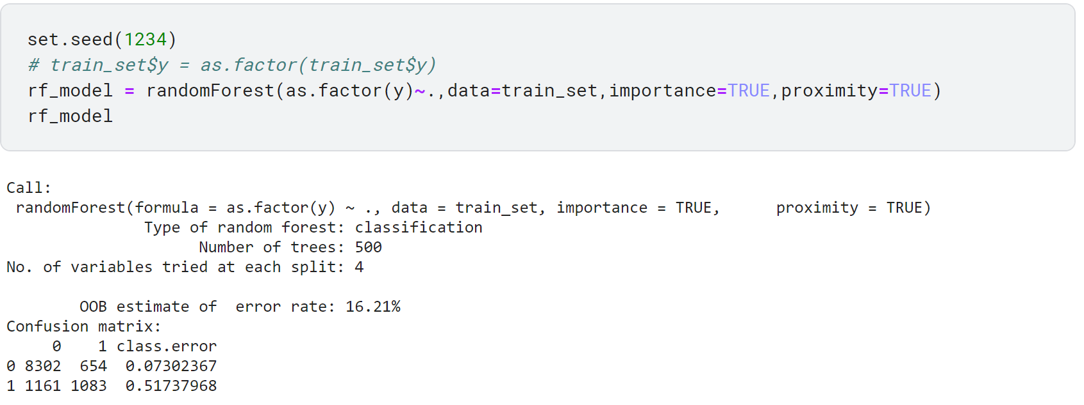
Notes:
Here is our basic model code, we use the random Forest library. From the result, we can see the information of the model and the confusion matrix, oob error.

Slide 7
Fine Tuning & Model Evaluation
Notes:
In order to improve the accuracy of the model, we can fine tune for it.

Slide 8
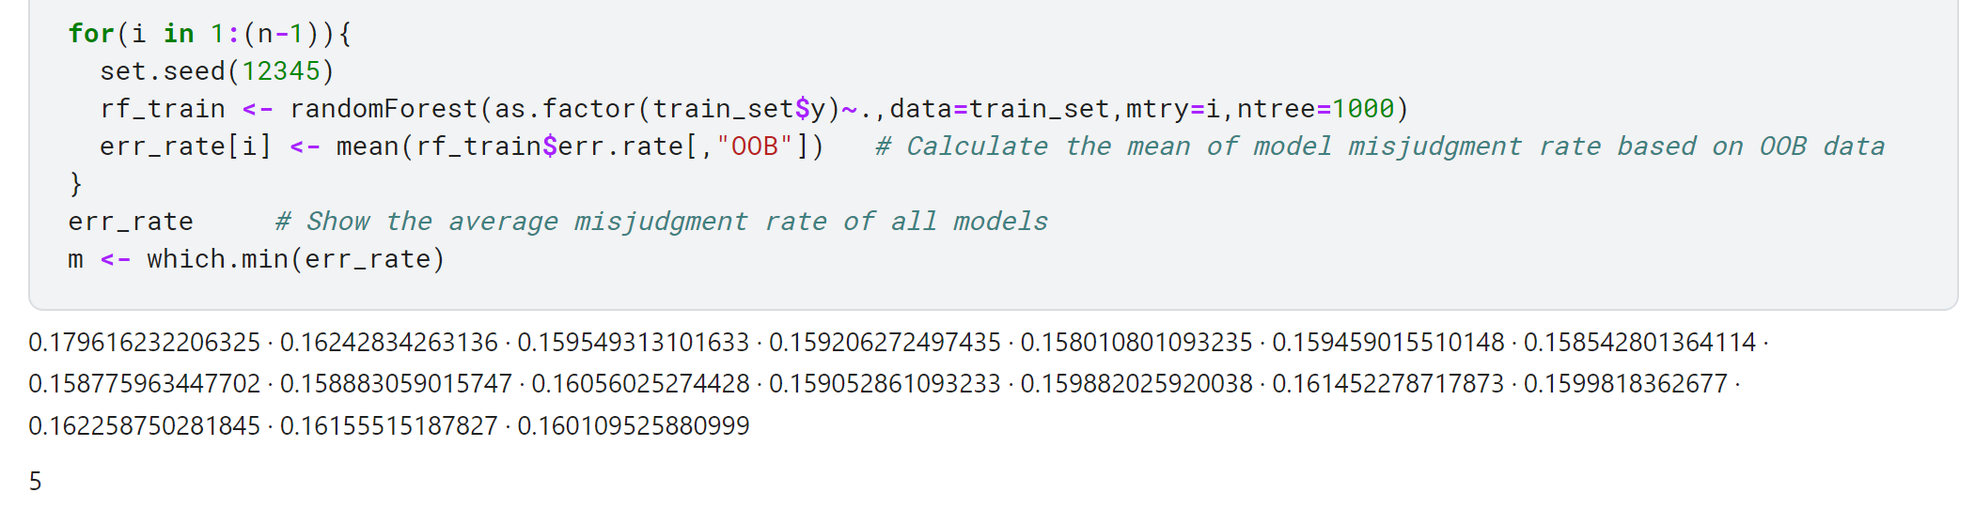
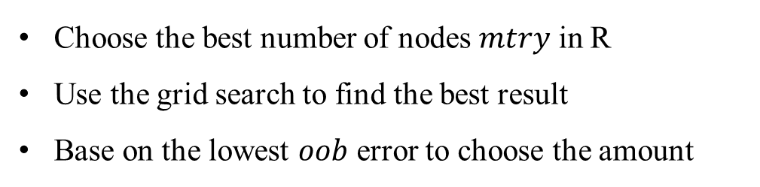
$$mtry$$
Choose the best number of nodes $mtry$ in R
Use the grid search to find the best result
Base on the lowest $oob$ error to choose the amount
Grid search: using a loop to traverse the number from 1 to the feature numbers
Notes:
Firstly, In order to choose the best number of branch points $mtry$, we can use the grid search to find the best result which means that using a loop to traverse the number from 1 to the feature numbers, and base on the lowest $oob$ error to choose the amount. We can see if here mtry =5 is the best amount of this parameter. And we will introduce the oob error later.

Slide 9
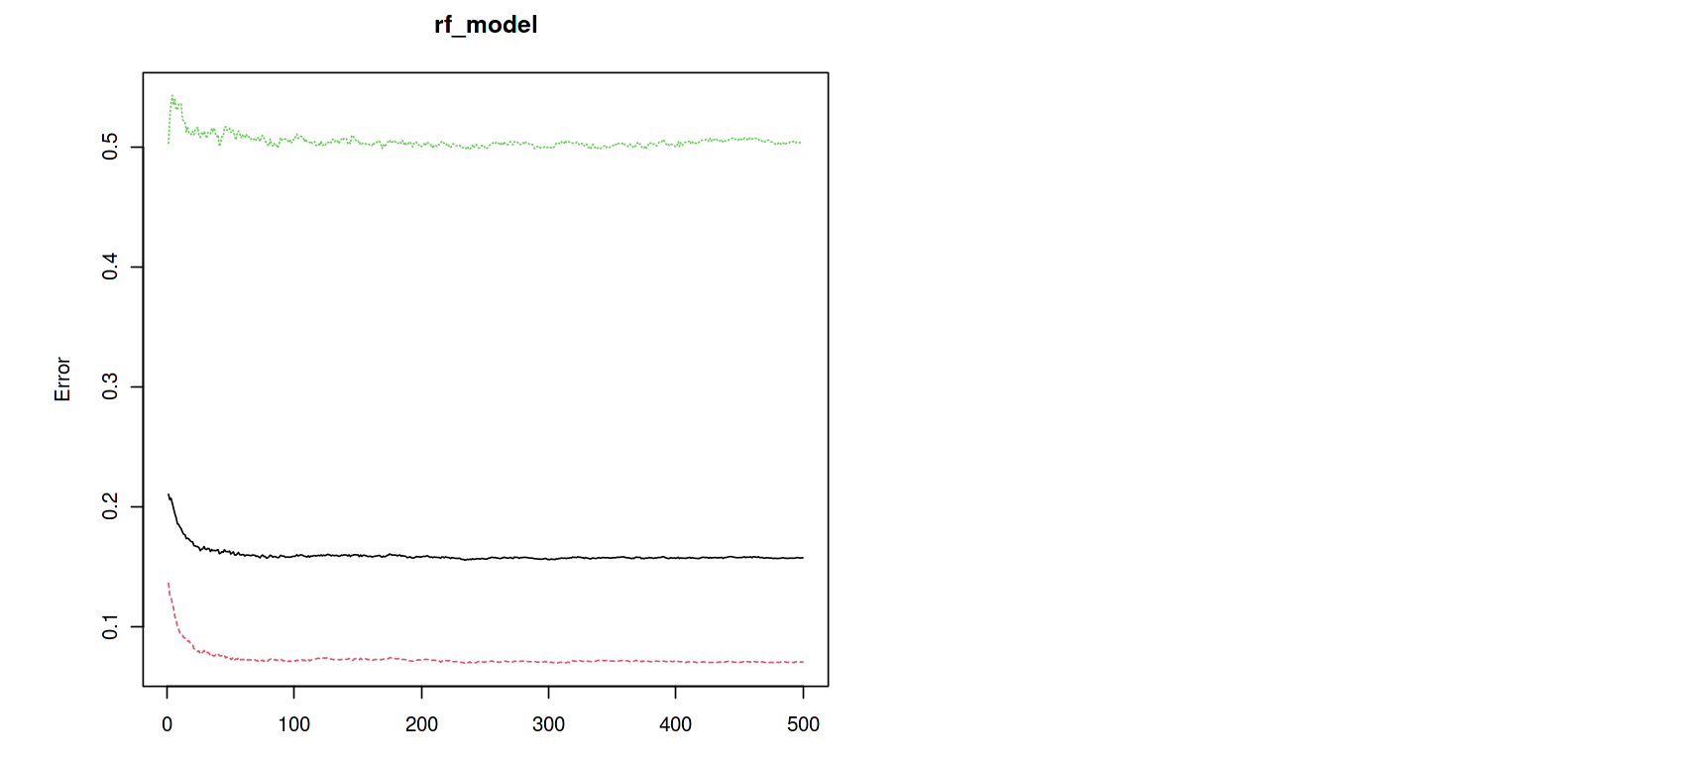
The number of the trees in the Forest
Plot the model and it will show the three cases of convergency
After a certain number of trees, the model almost stops converging
Too much will cost computing power, too little will fail to converge
Just keeping the default parameter settings is well!
Notes:
The number of decision tree in the “forest”, we can just plot the model and it will show the three cases of convergency. We can find the after a certain number of trees, the model almost stops converging, so we can just keep the default parameter settings.

Slide 10
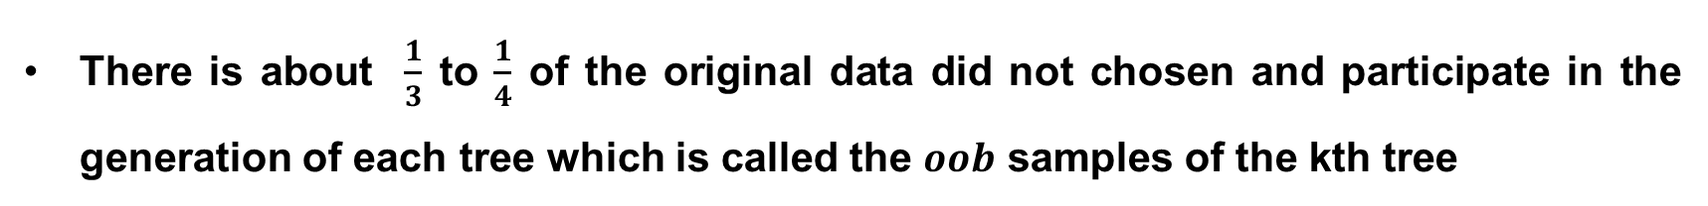
Out-of-bag error rate
Different random samples with replacement for the training set
There is about $\frac{1}{3}$ to $\frac{1}{4}$ of the original data did not chosen and participate in the generation of each tree which is called the $oob$ samples of the kth tree
Use the $oob$ (rest) samples to test the model and get the rate of the error
Notes:
We mentioned above that in constructing each tree, we used different random samples with replacement for the training set. Thus for each tree, about one third to one forth of the training instances did not participate in the generation of the tree, they are called the $oob$ samples of the kth tree. Then use the rest of sample to test the model and we can get the rate of the error.

Slide 11
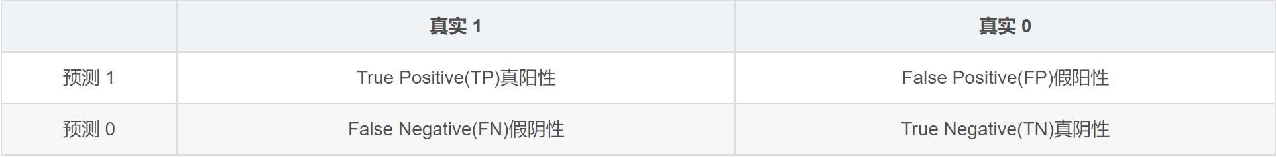
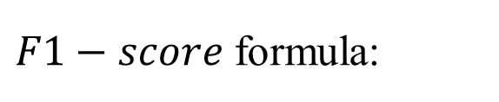
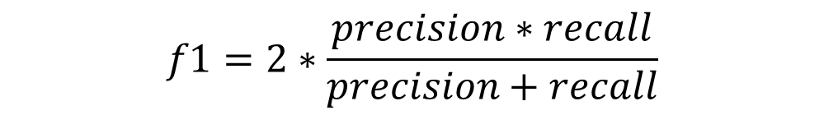
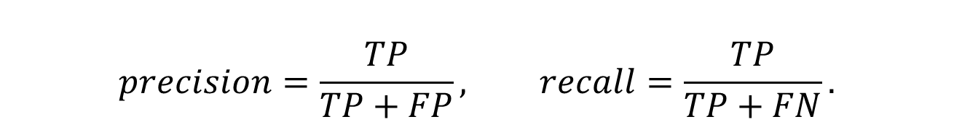
F1-score
$F1−score$ formula:
$$f1=2∗\frac{precision∗recall}{precision+recall}$$
$$precision=\frac{TP}{TP+FP}, recall=\frac{TP}{TP+FN}.$$
Notes:
F1 Score is an indicator used in statistics to measure the accuracy of a binary classification (or multi-task binary classification) model. It takes into account both the accuracy and recall of the classification model. The F1 score can be regarded as a weighted average of model precision and recall. Its maximum value is 1 and the minimum value is 0. The larger the value, the better the model.

Slide 12
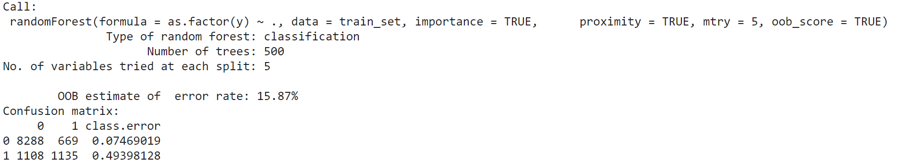
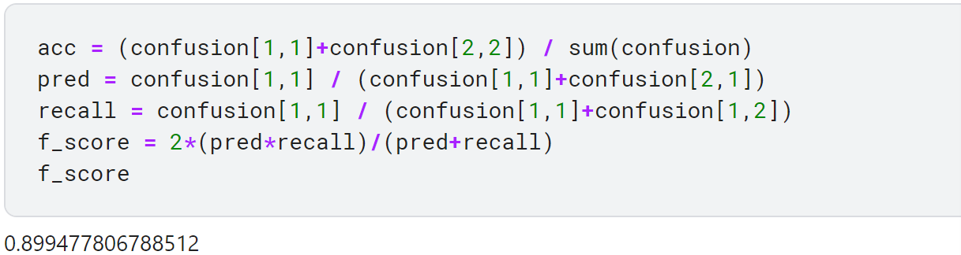
Model Evaluation
After fine tuning, we can find the $oob$ error just around 15.87% and $f1−score$ is 0.9.

